Slide 1

RESEARCH PROJ
This Photo by Unknown author is licensed under CC BY-SA.

Slide 2


CURRENT CHALLENGES TO OS
Security
Memory Management
Scaling
This Photo by Unknown author is licensed under CC BY-SA-NC.
This Photo by Unknown author is licensed under CC BY-SA-NC.

Slide 3

Current Challenges: Security
Determined through its ability to stop unauthorized interference and safeguard any vulnerable assets
Although OSs are slowly getting more secure over time, vulnerabilities and backdoors are still rapidly being discovered
These vulnerabilities compromise users and their data by exposing the device to hacks, malware, DOS attacks, and network intrusion
This Photo by Unknown author is licensed under CC BY.

Slide 4


Current Challenges: Memory Management
Basic issue in managing memory is knowing when to keep the data stored in the memory and when to throw it away to free up memory space
Presents an issue to programmers where manual memory management is required at times
Managing memory poorly can affect the robustness and speed of programs, creating even more issues
Memory leaks, premature frees / dangling pointers, poor reference locality, etc.

Slide 5
Current Challenge: Scalability
Scalability refers to increasing or decreasing the capacity of a system by making effective use of resources
As hardware becomes more powerful and workloads become heavier, a scalable and reliable OS is required for systems to function as efficiently as possible
In order to maximize longevity and use of an OS, it must be able to be scaled to accommodate any situation

Slide 6

Future Technologies and Applications
OS ENHANCED USABILITY
IOT INTEGRATION
ARTIFICIAL INTELLIGENCE INTEGRATED WITH IOT

Slide 7
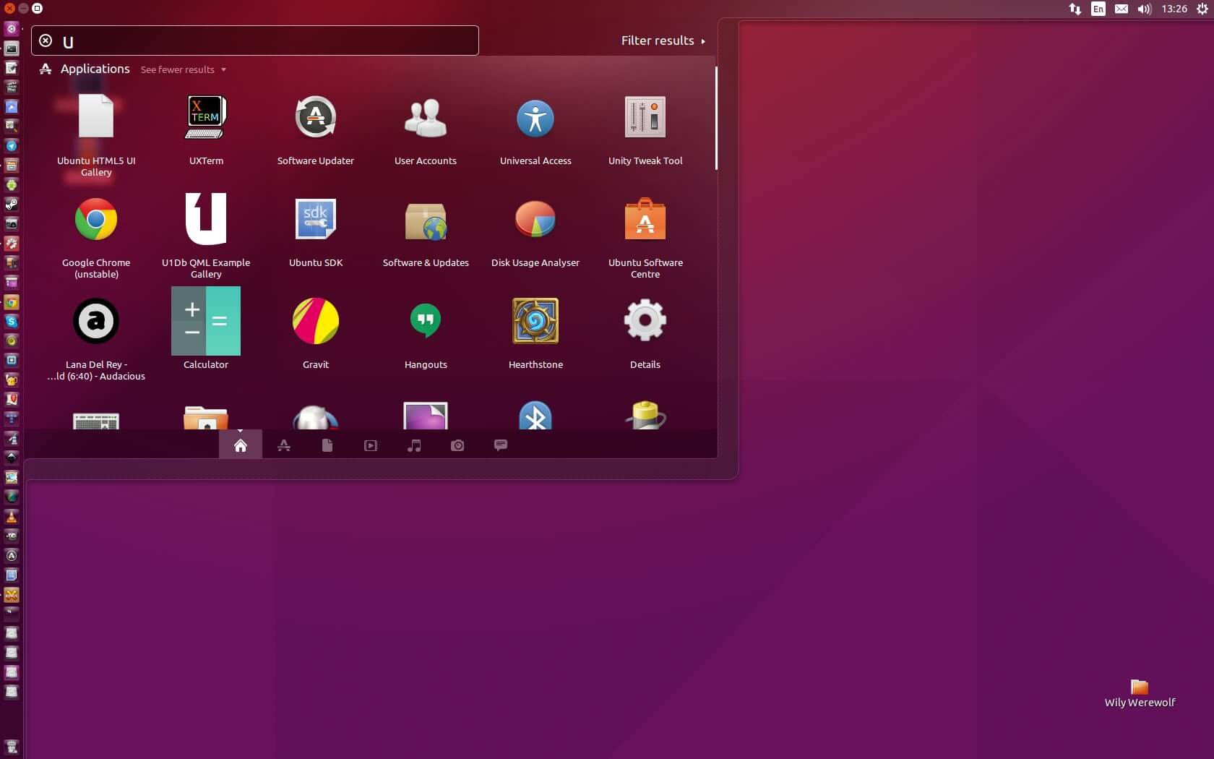


OS ENHANCED USABILITY
In the coming years mankind is eager to get most out of Operating Systems
To achieve this, Operating Systems will be developed for enhanced usability
What will the enhanced usability do?
It will help in minimizing the inaccuracies occurring in high-end programming through efficient memory management
Allow for the intermingling between two different Operating Systems at a more efficient level
Provide users with a modular platform on which many functions and features can be built
This Photo by Unknown Author is licensed under CC BY-NC-ND
This Photo by Unknown Author is licensed under CC BY-NC
This Photo by Unknown Author is licensed under CC BY-SA-NC

Slide 8


SOMETHING FOR EVERYONE !!
Accessibility is another key part in enhanced usability, allowing for everyone to operate a device as they wish
According to a report, Microsoft is working on making Windows “Accessible by design“, with the help of artificial intelligence and machine learning.

Slide 9

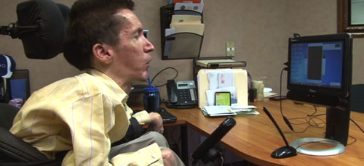
Some of the advancements which are used now and can be upgraded in the future are:
AI can be embedded in Microsoft office, which can be used by the visually impaired to interact with Office 365.
Screen Readers can be much improved which will help the blind to discover a new way of enhancing their productivity and interaction with technology
Immersive Readers can be seen as a boon for people looking for the comprehension of PowerPoint Slides and notes.
This Photo by Unknown Author is licensed under CC BY-SA-NC
This Photo by Unknown Author is licensed under CC BY-SA

Slide 10

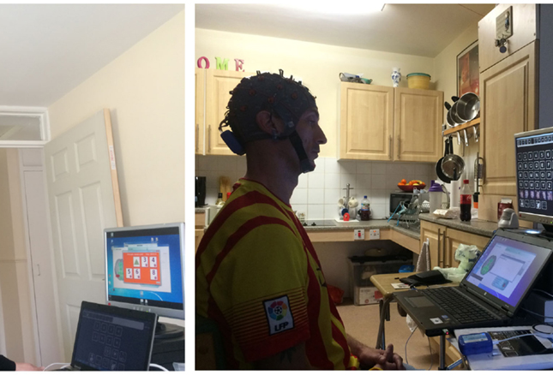
IoT INTEGRATION
IoT devices are looked forward to for bettering the living standards of everyone in the coming decades
One example of the proposed advancements in the IoT space:
Full integration between the home and smart devices – Smart devices like locks, cameras, temperature sensors, etc., will allow for full control of your home from one central device
This Photo by Unknown Author is licensed under CC BY
This Photo by Unknown Author is licensed under CC BY

Slide 11
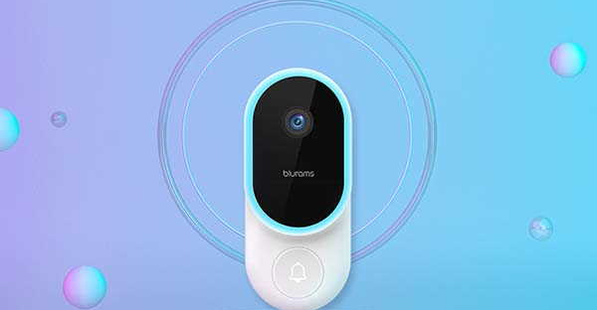
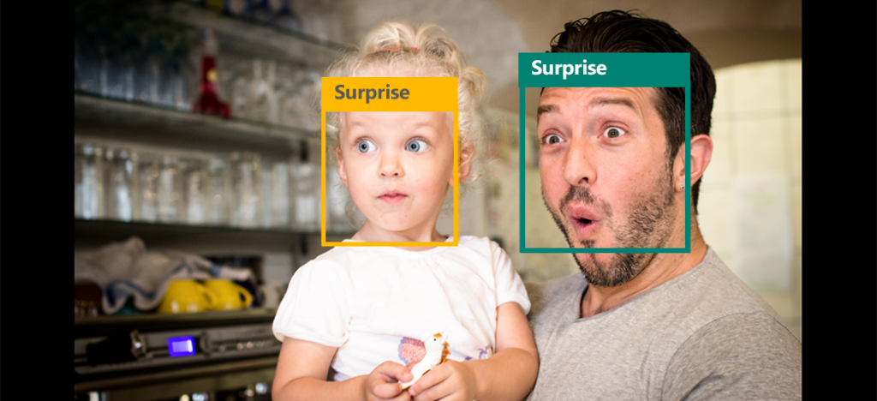
IoT integration with Facial Recognition
The combination of AI with IoT devices will be a huge success for the whole of mankind
Facial Recognition Technologies - Facial recognition will act as a replacement for the traditional door cameras. These devices will be able to detect people based on their facial characteristics using trained AI, and will be able to determine who they are and whether a person is allowed to have access to the house or facility they are trying to enter
This Photo by Unknown Author is licensed under CC BY-SA-NC
This Photo by Unknown Author is licensed under CC BY

Slide 12


Hurdles to Overcome
A Refined OS – Creating an OS that is highly secure, hyper-scalable, and can seamlessly work in tandem with the hardware it is provided, is necessary in order to compute the technologies of the future
Creating a Competent AI – In order to achieve the ease of use and accessibility capabilities of future technology, a fleshed-out and competent AI must be created
Quantum Computing – Can use the powerful problem-solving capabilities of quantum computing to develop AI and machine learning algorithms that would be either very difficult or even impossible to implement with classical computing

Slide 13


Hurdles to Overcome
Cost - Creating, researching and developing these new technologies always has the caveat of costing millions if not billions of dollars.
Information Security Challenges – Ensuring that the design for a project is secure is a huge factor in the R&D process. Whether it is code for software or design plans for hardware, ensuring that none of this information is stolen or corrupted is critical.
Lack of contributors - It a widespread belief that open-source software should be free, and that those who work on it should be motivated by passion and sheer willpower rather than a paycheck. As a result, most open-source volunteers must code in their spare time. This may lead to a lack of developers, preventing projects from moving forward with development.

Slide 14
Sources and References
https://www.techopedia.com/definition/24774/operating-system-security-os-security#:~:text=Operating%20system%20security%20(OS%20security)%20is%20the%20process%20of%20ensuring,malware%20or%20remote%20hacker%20intrusions.
https://www.memorymanagement.org/mmref/begin.html
https://en.wikipedia.org/wiki/Quantum_memory
http://groups.csail.mit.edu/carbon/docs/caos_final.pdf
https://www.hpcwire.com/2015/10/05/defining-scalable-os-requirements-for-exascale-and-beyond/
https://www.conceptatech.com/blog/importance-of-scalability-in-software-design#:~:text=Scalability%20is%20an%20essential%20component,user%20experience%2C%20and%20higher%20agility.
https://www.forbes.com/sites/tomtaulli/2020/08/14/quantum-computing-what-does-it-mean-for-ai-artificial-intelligence/?sh=27c61c6e3b4c
https://blogs.microsoft.com/blog/2021/04/28/doubling-down-on-accessibility-microsofts-next-steps-to-expand-accessibility-in-technology-the-workforce-and-workplace/
https://fpf.org/wp-content/uploads/2018/05/Privacy-and-Accessible-Iot-Outline-with-Case-Studies-FINAL.pdf

